Slide 1
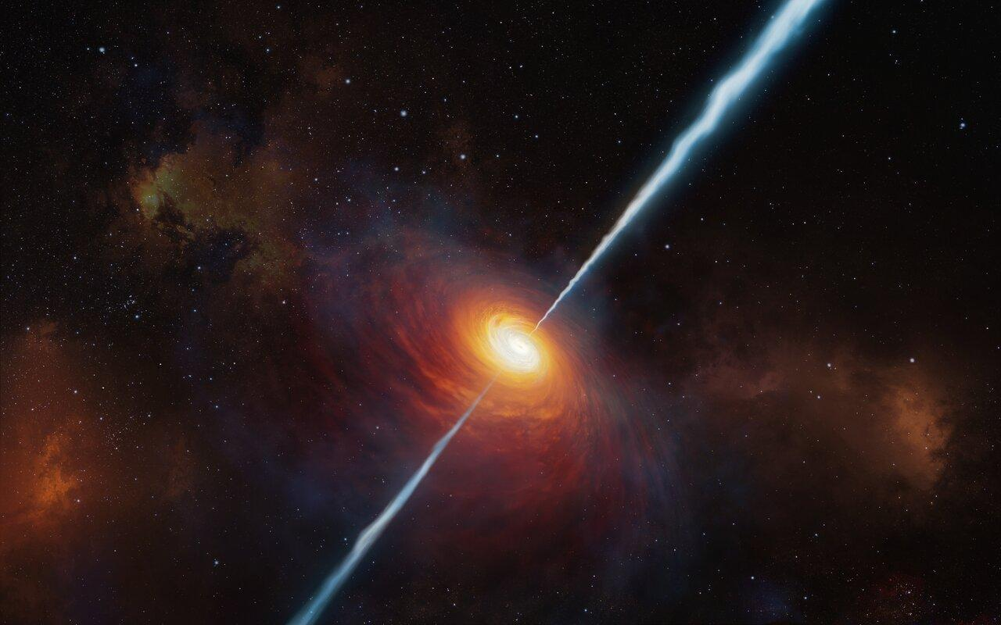
Stellar Objects
Hands-on-Machine Learning 2024
A Presentation By Jakub Wisniewski, Lukas Lang, Southik Banerjee

Slide 2
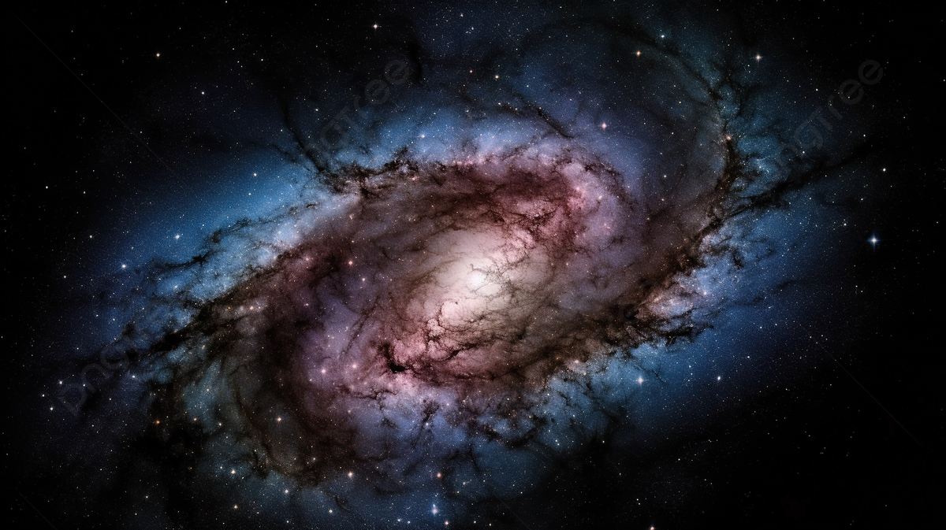
About the Dataset
• The dataset was originally published by the ‘Sloan Digital Sky Survey’-project (SDSS) in January 2022
• Dataset consists of 100,000 instances and 18 attributes.
obj_ID, run_ID, field_ID, spec_obj_ID, fiber_ID
alpha, delta, cam_col, plate
u, g, r, i, z
redshift
MJD
class (Galaxy, Star, Quasar)

Slide 3
Goal for the project:
Predict the astronomical type of an object as either Galaxy, Star or Quasar
=> Supervised multiclass classification problem with an imbalanced dataset
=> “Main” Metric: F1-score (weighted)
=> Models we implemented:
kNN
Logistic Regression
Decision Trees,
Random Forest
Extra Trees
Support Vector Machines
Gaussian Naive Bayes
Neural Networks
Histogram based Gradient Boosting

Slide 4
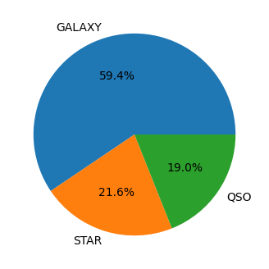
Data Preparation
The dataset is imbalanced and has no missing values or duplicates
11 out of 17 features are uncorrelated in relation to our target ‘class’
7 of them are ID’S
alpha and delta
Cam_col
MJD
We also encoded each class label as a number
0 as Galaxies
1 as Stars
2 as Quasars
As we can see, approximately 60% of the samples are Galaxies, whereas Stars and Quasars appear at ~20%

Slide 5
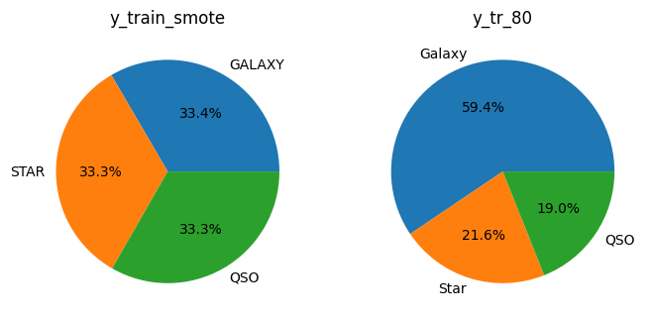
Train-Test Splits
We tried 4 different splits:
Stratified:
80/20
90/10
95/5
SMOTE*
80/20
SMOTE (Synthetic Minority Over-sampling Technique) split has equally distributed classed (which can help with our imbalanced dataset) in comparison to 80/20 split
*SMOTE creates synthetic samples by analyzing existing minority data points and generates new ones similar to them. By adding these synthetic samples, SMOTE balances the data, giving the model a better chance to learn the minority class.

Slide 6
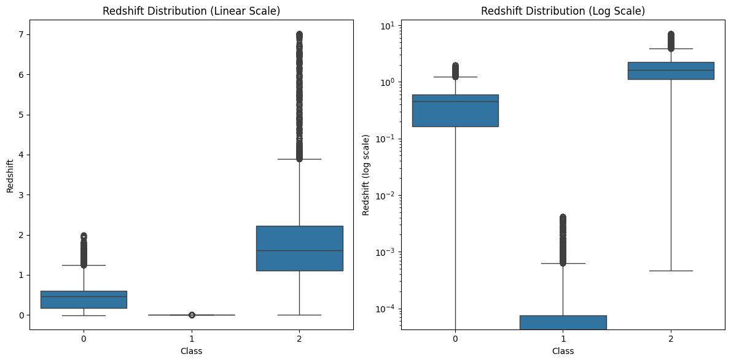
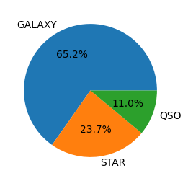
Removing Outliers
We tried to remove the outliers using IQR
=> Every feature will be investigated separately
=> Unfortunately the IQR method does not work well because Quasars tend to have significantly higher redshift than Stars and Galaxies:
Distribution after the removal of the ‘outliers’

Slide 7
Visualizing the Data

Slide 8
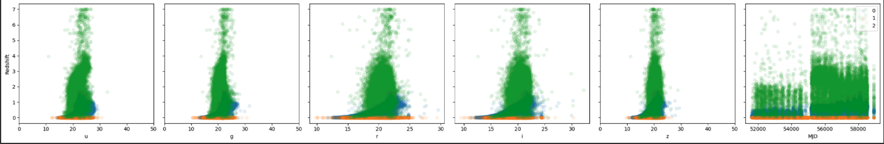
Pair plots
For ultraviolet, green and inferred, the points are more narrowly centered when the wavelength is 20nm.
For every wavelength stars constantly remains at a redshift of 0, as stars are the closest stellar object.
Galaxies have a slightly higher redshift and ranges between 0 and 2.
Stellar objects tend to emit high amount of UV light, and as the light travels its gets “stretched” causing it to transform into red and green light, then into near-infrared light.
For this reason quasars have less of a “spread” when we look into UV and green light, but thats why there are more points and seem slightly more spread out.
(nm)

Slide 9
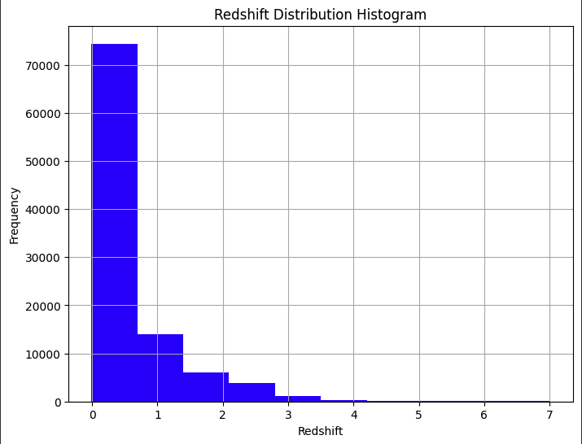
Further Exploration
There are more than 70000 observed object.
From 0 to about 0.8 and the frequence rapidly drops.
This suggests that majority of observations in the dataset have objects quite close to us, and there are few observations (compared to other observations) that have intermediate to higher redshift.
< 0.5 | Low Redshift
0.5 - 2 | Intermediate Redshift
> 2 | High Redshift

Slide 10
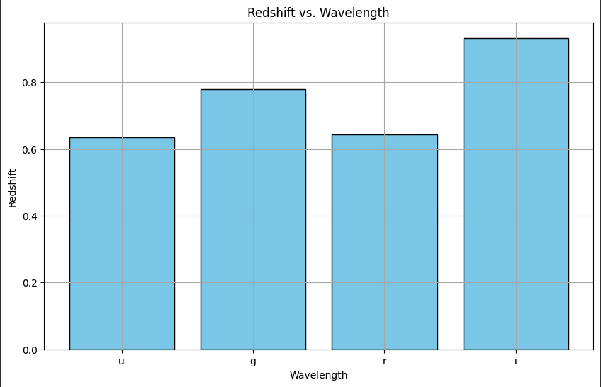
Further Exploration
As the light from the object travels further the light's wavelength gets "stretched".
Galaxies and Quasars produce high amounts of ultraviolet light, which slowly gets red shifted into green/red then to near-infrared.
But the redshift for red is the same for UV eventhough red has a longer wavelength than UV.
The universe is expanding, all wavelengths are affected equally, so the redshift should increase uniformly.
This could be because of space dust making it harder to detect higher redshift objects whereas near-infrared is able to penetrate dust more effectively.

Slide 11
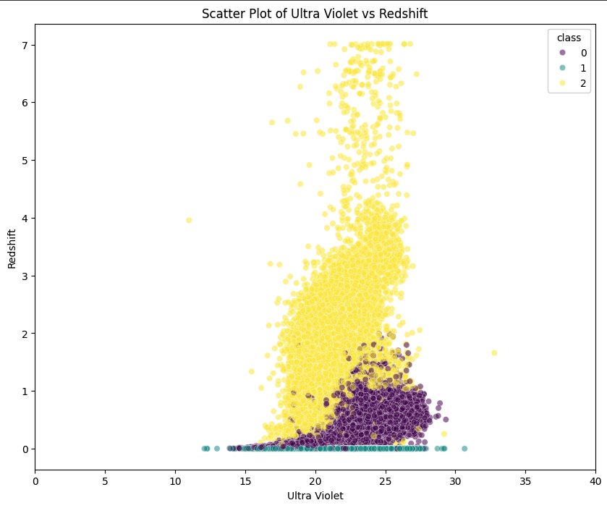
Further Exploration
Notice that the overlap of points between galaxies and quasars is much more significant compared to the overlap between Stars and Galaxies.
This might be a hint that there is potential for some misclassification between Galaxies and Quasars.
Majority of the Quasars are below a redshift of 4
(nm)

Slide 12
Models

Slide 13
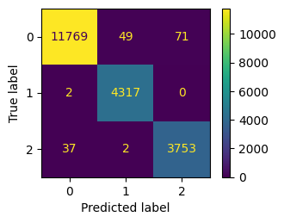
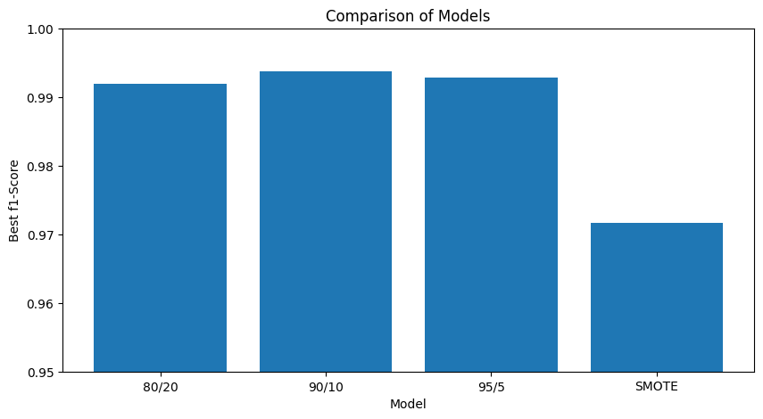
KNN
Training on all of the 4 train splits
Hyperparameter tuning for n_neighbors (range between 1 and 45)
Very good f1 scores for the train sets = > ~ 95 %
Suspiciously high test scores of ~ 99%
Validation and explanation in the following
About 1 hour of training
Example Conf. Matrix for 80/20 test set

Slide 14
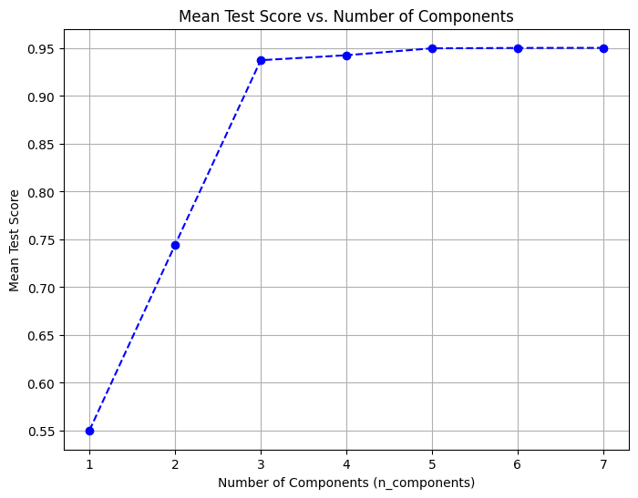
KNN
Time optimization with PCA
=> 8 dimensional dataset could be reduced to 3 dimensions with less than ½ computational time
Same insanely high test scores with a very naive implementation
Dataset depends mainly on redshift
=>Easy to split the small test sets

Slide 16
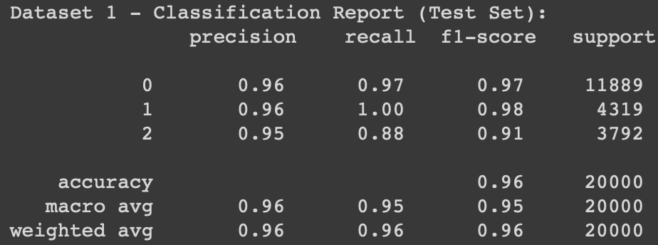
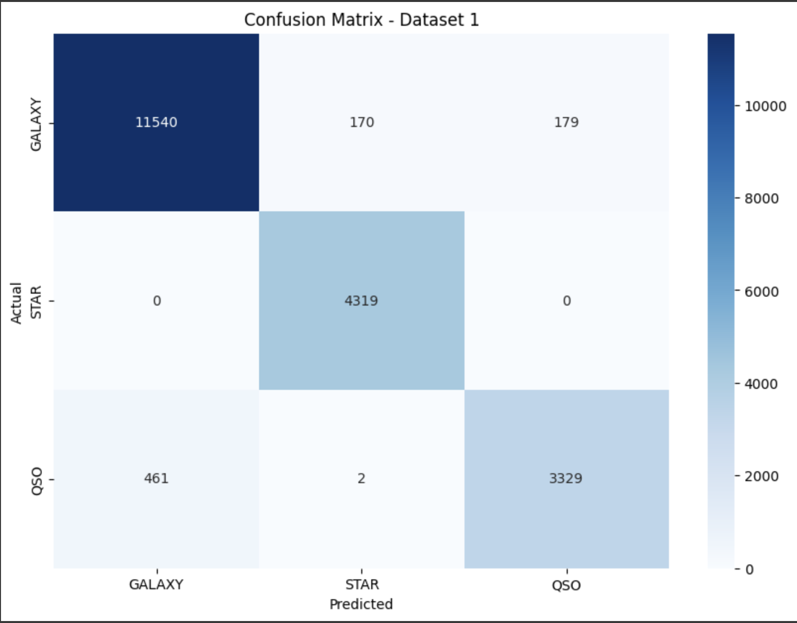
Logistic Regression (Standard Implementation)
Example: Test-split (80/20):
- (80/20 ) had the best performance, with an average test f1 score of about 95%, which remained the same for later methods.
- Weighted test f1 score is already pretty good for all the splits. (80/20) was just a bit better at 0.96.
- As we expected the model had issues with classifying Galaxy and Quasars. This was especially present in (80/20) and SMOTE.
- Recall for Galaxy and Stars is very good (0.97 and 1.00)
- Total elapsed time: about 32 seconds

Slide 17
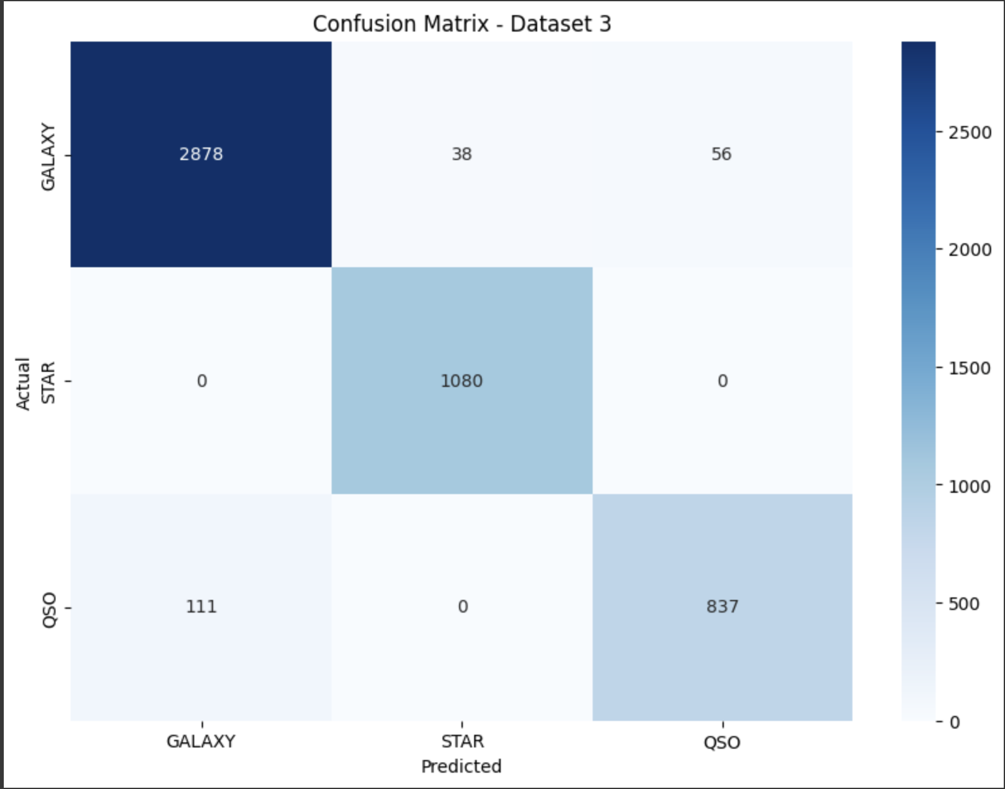
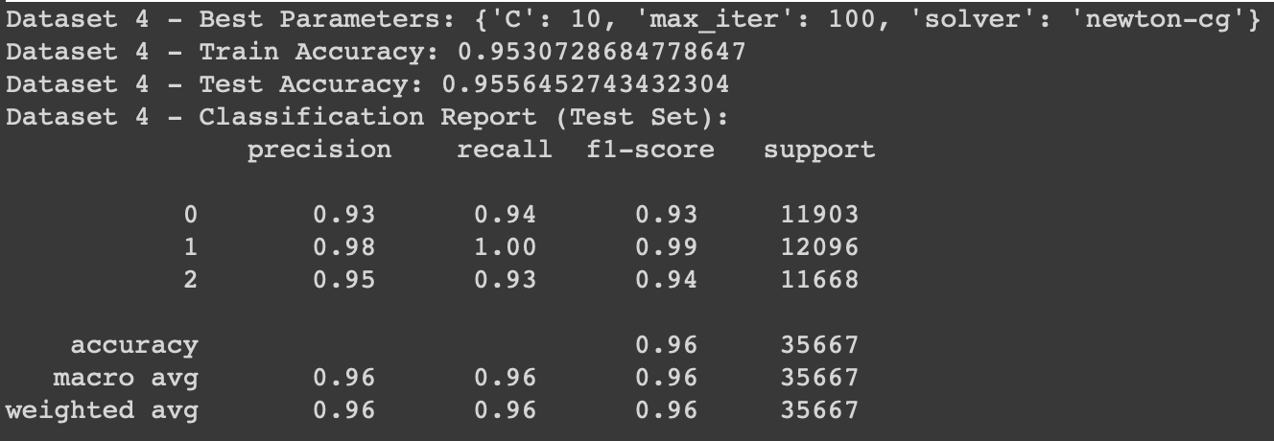
Logistic Regression (Hyperparameter tuning)
Example Test-split (95/5):
- Weighted test f1 scored remained the same at 0.96 for SMOTE.
- Best hyperparameter, C, is 10 (relatively low regularization).
- Recall for Galaxy has slightly dropped, but quasars has increased.
- This misclassification between Galaxy and Quasars has improved for (95/5).
- Total elapsed time: about 25 minutes (slower & same results)
Example Test-split (SMOTE):

Slide 18
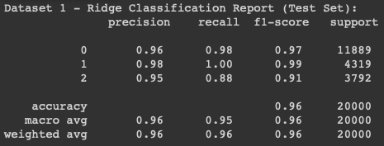
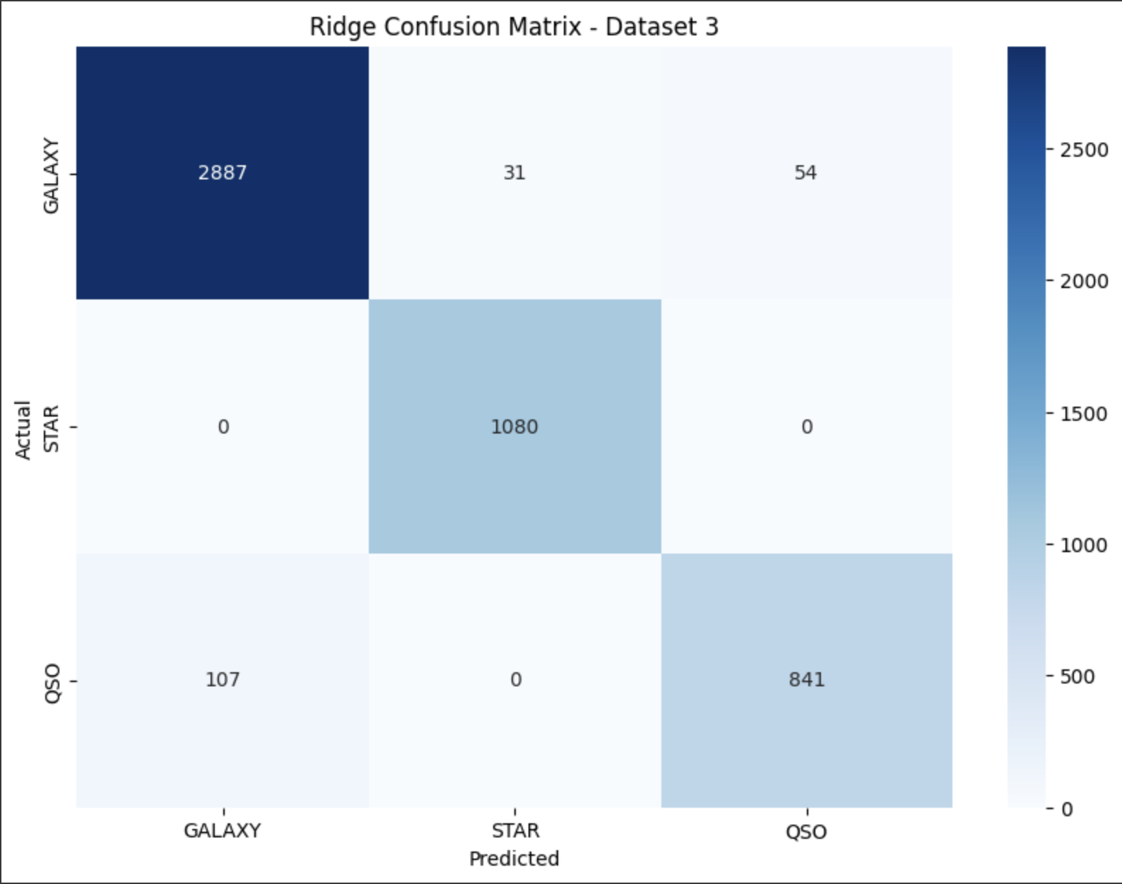
Logistic Regression (Ridge Regression)
Example Test-split (80/20):
- Best hyperparameter, C, is 100 (relatively low regularization).
- Weighted test f1 score remained the same at 0.96
- This misclassification between Galaxy and Quasars for (95/5) has reduced even more.
- Recall for galaxy has improved even more, but Quasars is dropping.
- Total elapsed time: 7 minutes, so faster with same results.

Slide 19
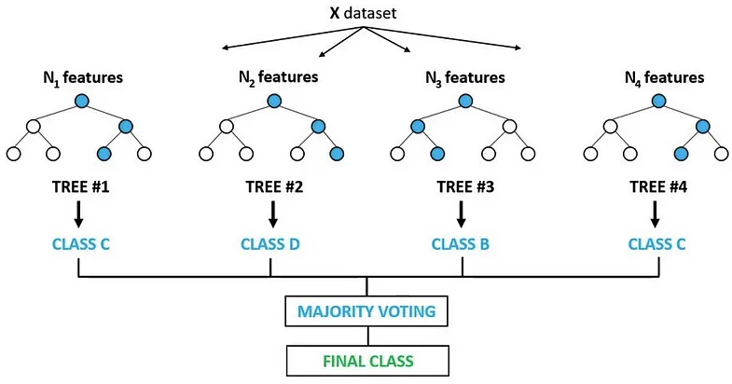
Random Forest
Combines the output of multiple decision trees to reach a single result
Pretty high F1 test scores (>97%) on each train-test split
Not the fastest model
Using a large number of trees in the forest or having a big dataset can be computationally expensive
Example Random Forest Classifier Representation

Slide 20
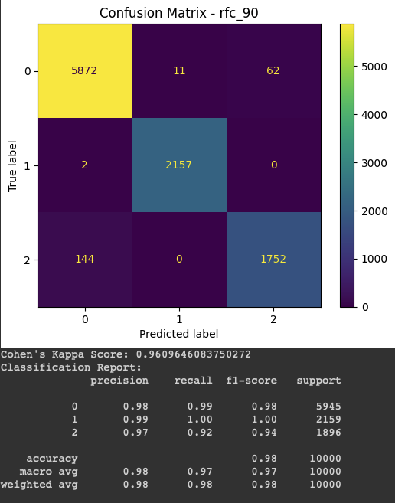
Random Forest (Hyperparameter Tuning)
Parameters from the grid search for our train-test split model (90/10):
Max depth: 10
Max features: log2
Min samples leaf: 1
Min samples split: 2
N_estimators: 500
Others are on default settings
F1 test scores improved by 0.1%

Slide 21
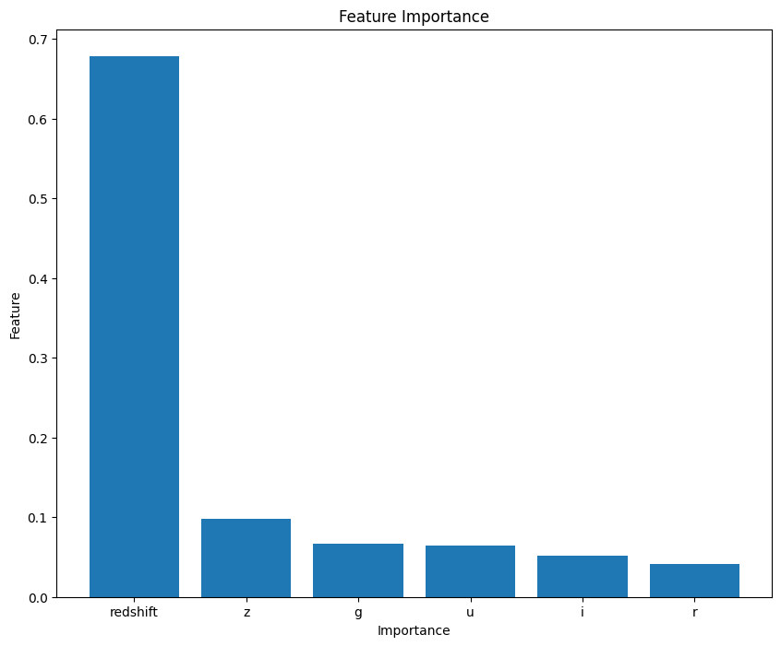
Random Forest (Feature Importance)
Clearly we can see that redshift is the most important feature in our data set for this model
Therefore, less complicated models can often be a better solution to our problem
Random Forest is usually difficult to interpret because they consist of many of individual trees

Slide 22
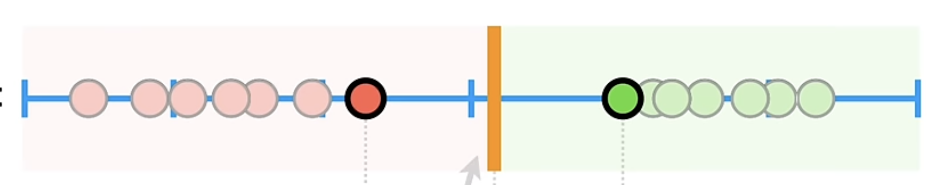
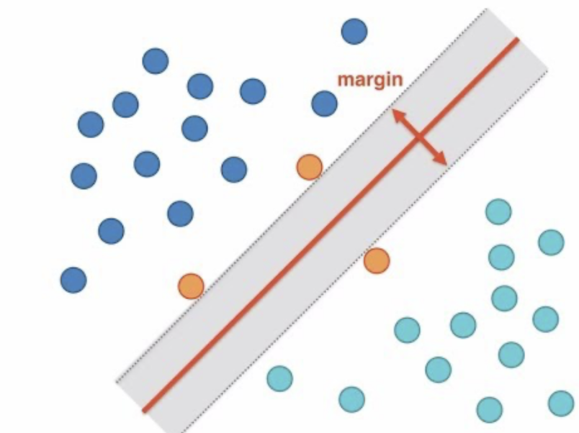
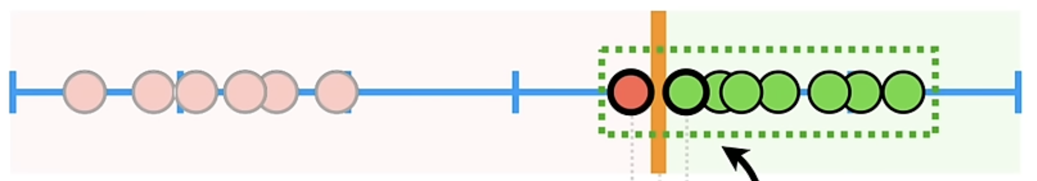
Support Vector Machine
Support Vector Machines finds the best hyperplane that separates one class from another. The "best" hyperplane is based on finding the largest margin separating the classes. See figure below:
But one of the issues is that if there is an outlier, then the hyperplane will overfit, reducing the accuracy of the test set:
To fix this we must allow misclassification which is know as bias/variance trade-off. We do this by adapting the value for C. Normally, the value is 1.0. The margin between the observation and threshold that allows misclassification is called the soft margin. Since they can allow misclassifications it makes it good for datasets with outliers.

Slide 23
Support Vector Machine
Advantages:
Effective in high dimensional spaces.
Uses a subset of training points, so it is also memory efficient in certain cases.
Versatile: different Kernel functions

Slide 24
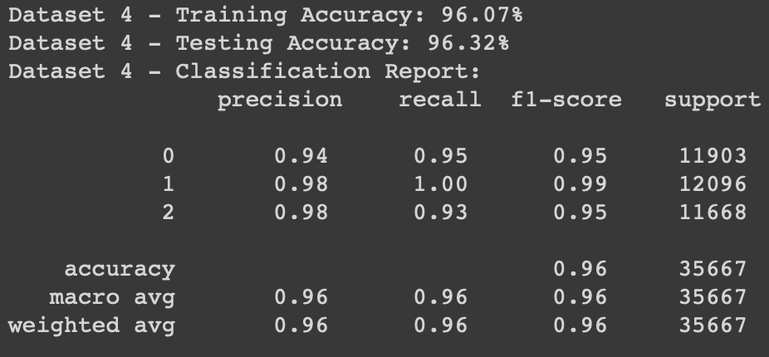
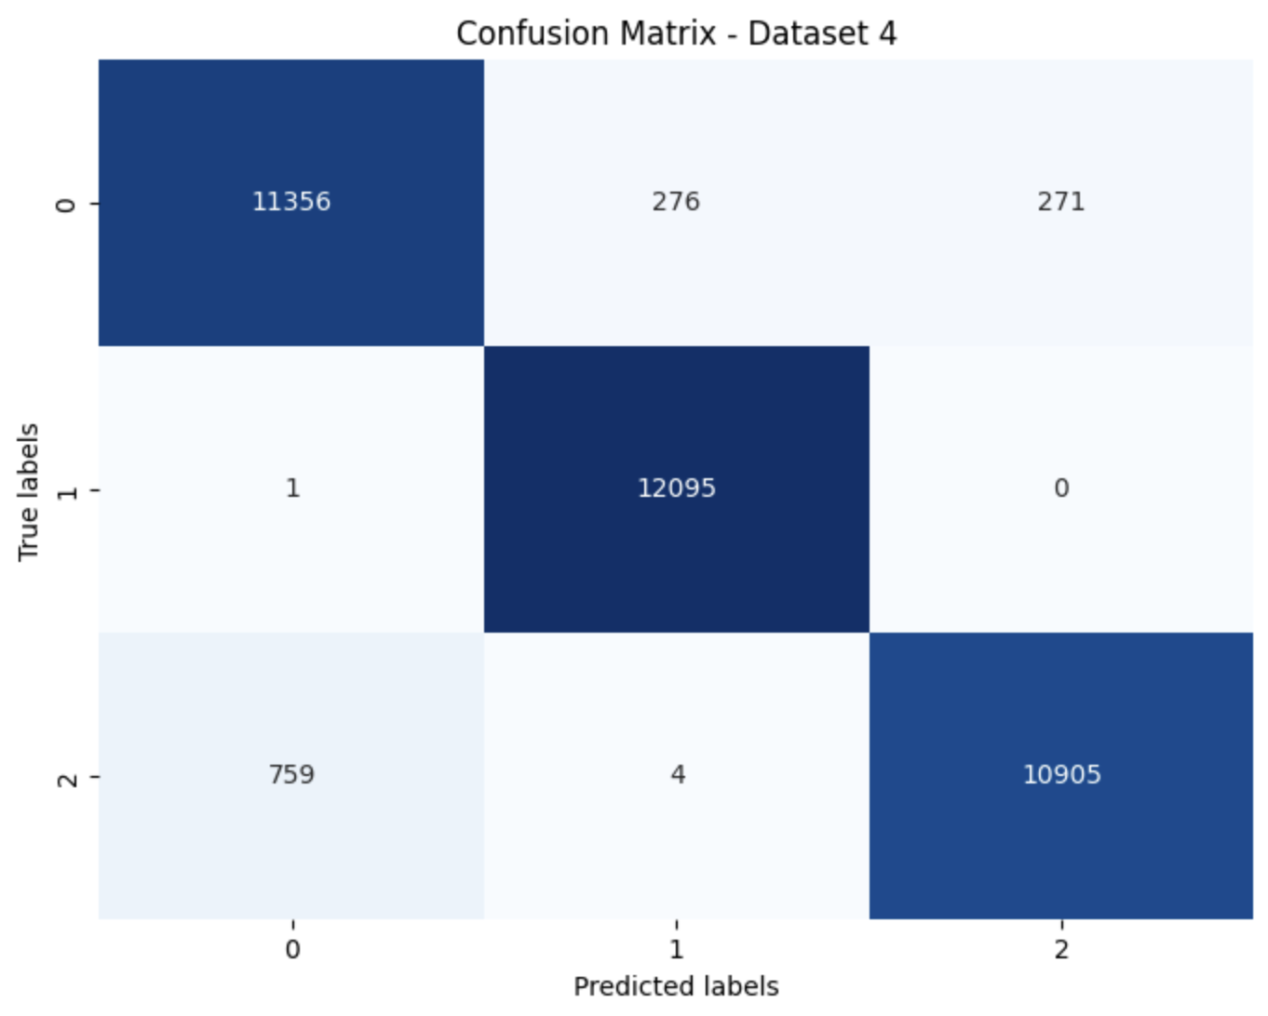
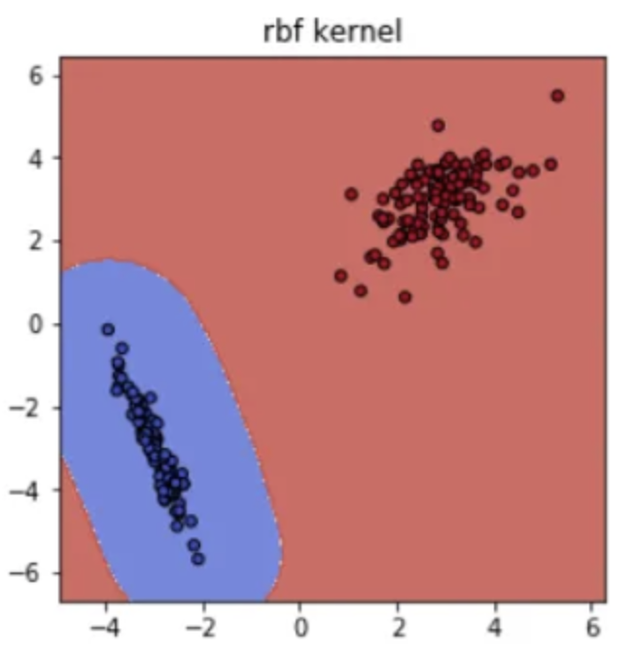

Support Vector Machine (Basis implementation with RBF kernel)
Example: Test-split (SMOTE):
- SMOTE had the best performance, with an average test f1 scores 96%.
- There were quite a few misclassification between galaxy and quasars, and a few between star and galaxy.
- The weighted test f1 score for every train-test split was 0.96.
- Most of the time galaxy had the highest test f1 score.
- Total elapsed time: about 14 minutes

Slide 25
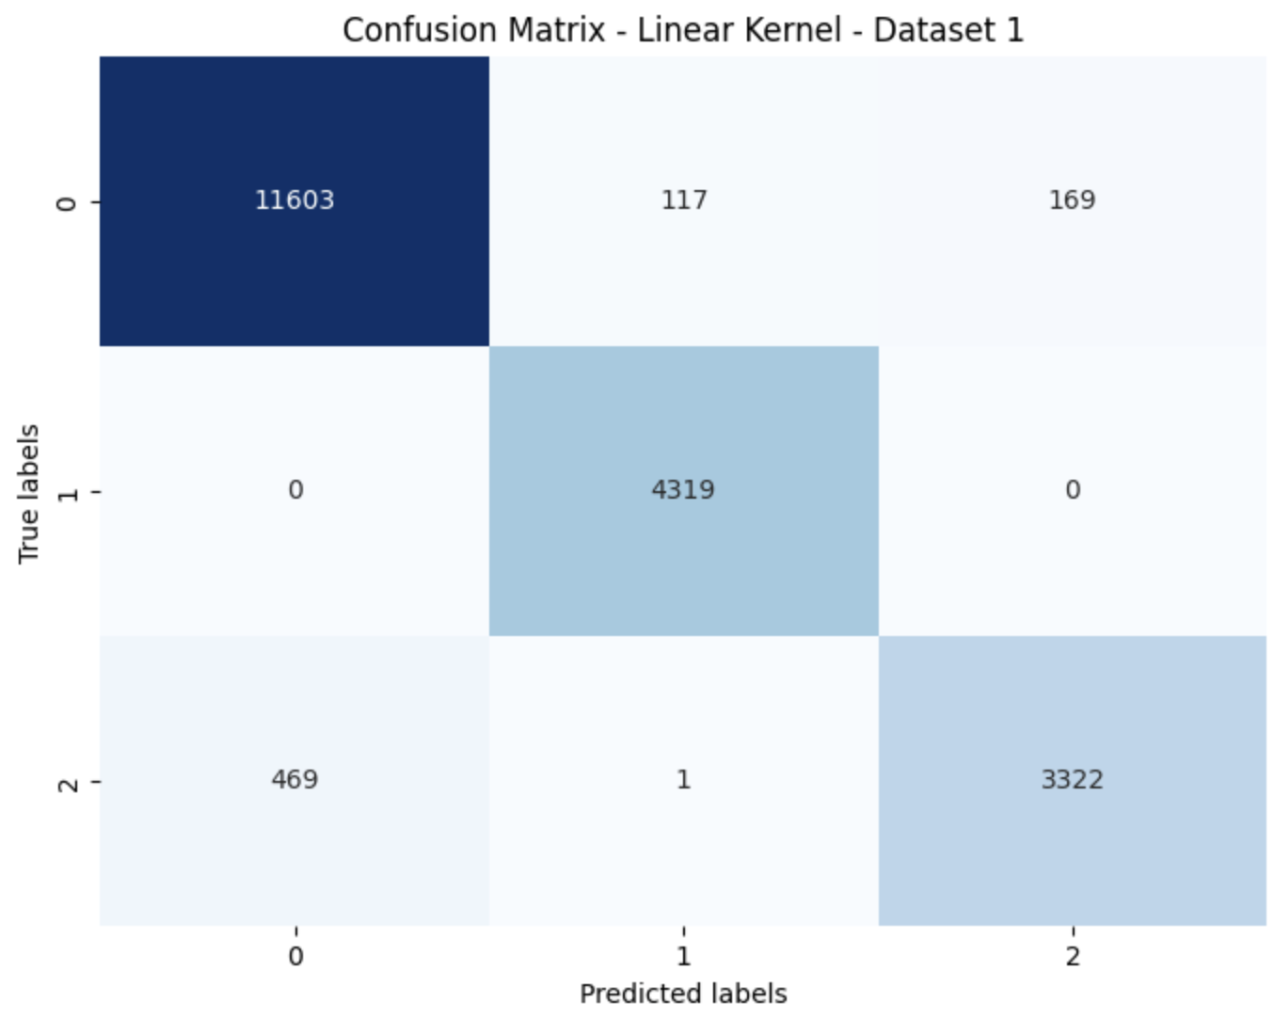
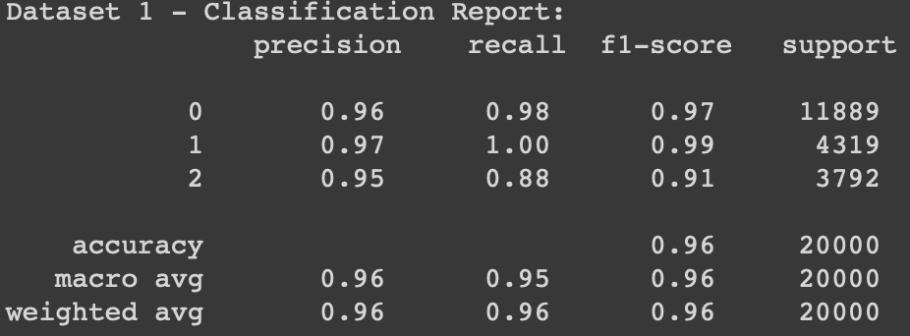
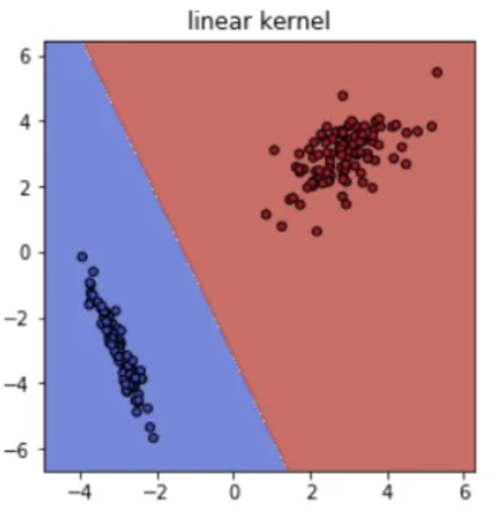
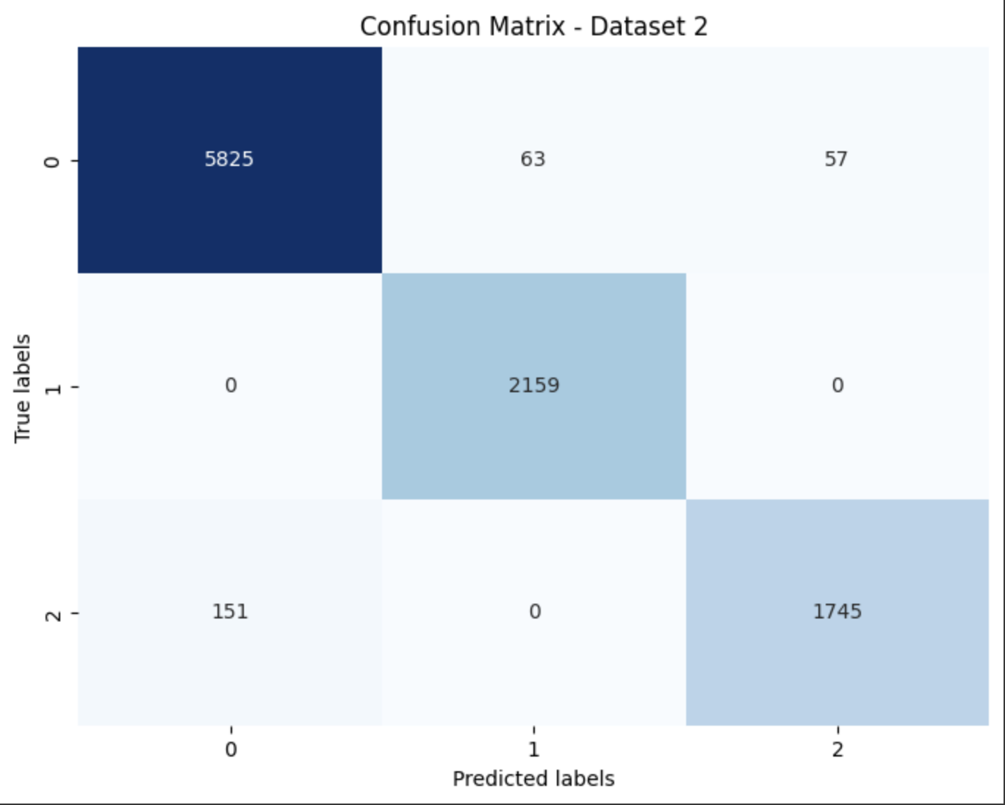
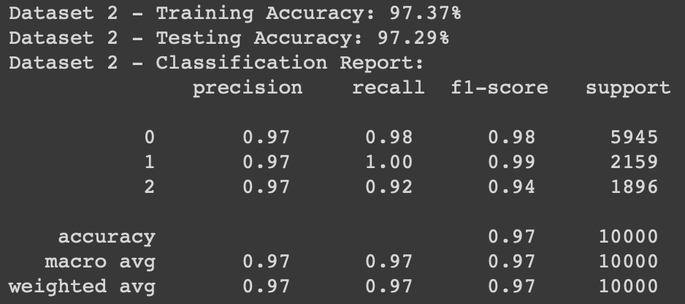
Optimization methods
Linear Kernel Selection:
- (80/20) had the best performance, with an average test f1 scores 95% (worse with same time).
- There were quite a few misclassification between galaxy and quasars, and a few between star and galaxy.
Total elapsed time: about 14 minutes
- Stars and Galaxy have near perfect f1 scores.
Cross Validation (optimal soft-margin):
- (90/10) had the best performance, with an average test f1 scores 97%.
- Improvement between Galaxy and Quasars.
Total elapsed time: about 60 minutes
- The weighted f1 score for most train-test split was 0.97.

Slide 26
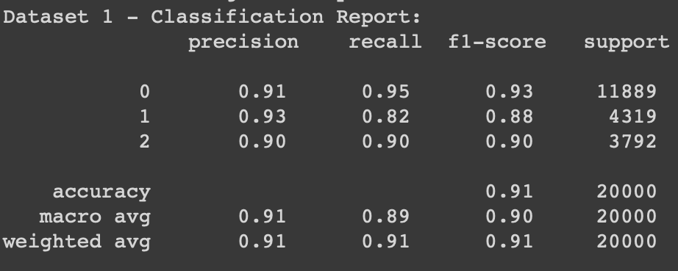
Optimization methods
Stochastic Gradient descent:
- Performance got worse, best was (80/20) with an average test f1 score of 90%
- Weighted f1 score dropped to 0.91
- But was much faster.
Total elapsed time: about 5 seconds

Slide 27
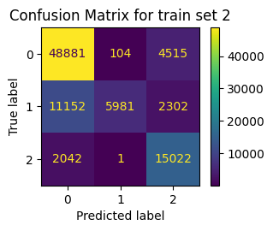
(Gaussian) Naive Bayes
Different types of the Naive Bayes classifier:
Gaussian
Multinomial
Complement
Bernoulli
Categorical
Extremely fast, but bad estimator
Weird behavior for different train/test splits
=> Naive assumption leads to unreliable results
=> Nice theoretical application of the Bayes´ Theorem from Semester 1

Slide 28
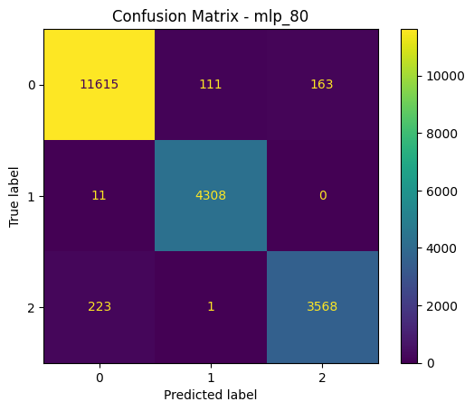
Neural Network (Multilayer Perceptron Classifier)
Computations are difficult and time consuming
More than 1 hour
F1 test scores above 97%
Such results can be obtained with other faster models
Better with more complex problems
Confusion Matrix for 80/20 split

Slide 29
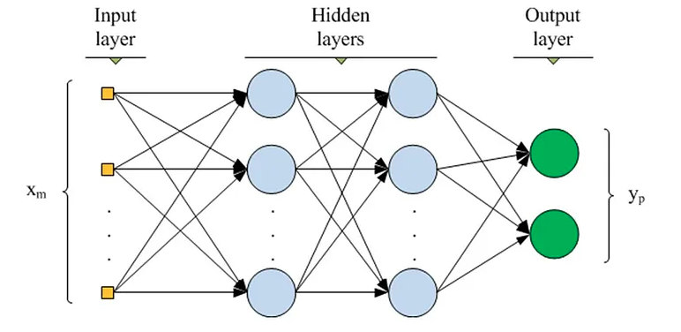
Neural Network (Hyperparameter Tuning)
Standard Scaler
After relatively small gridsearch we got best parameters for our problem
Activation function: ReLU
Solver: Adam
Alpha: 0.0001
Two hidden layers: (100, 50)
Learning rate: Constant
Max_iter: 500
Rest left on default
F1 test scores better by 0.5%
Example Neural Network with 2 Hidden Layers Representation

Slide 30
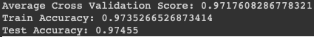
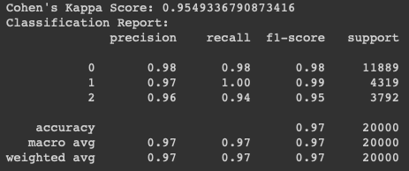
Neural Network (Outline)
Results were about the same for each split
Possibility to implement GPU-based neural networks (scikit-learn does not offer this)
Because our problem is heavily based on the redshift, neural networks are a little bit of an overkill
Results for 80/20 train-test split

Slide 31
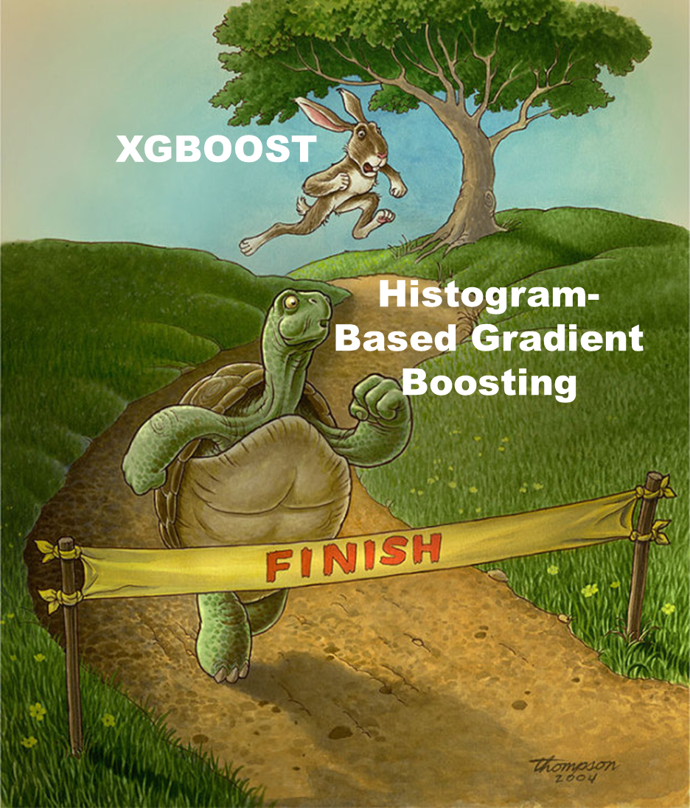
Histogram based Gradient Boosting
HGB instead of “normal” GB due to size of dataset
Hyperparameter tuning for ‘learning rate’ and ‘max_depth’
Typically small learning rate
Not too deep trees
Very good f1 scores for the test sets despite:
Small effort => ran almost as good without any tuning
Relatively short computation time (roughly 25 min)
'learning_rate': [0.0002, 0.002, 0.02, 0.05, 0.1, 0.2],
'max_depth': [3, 5, 10]}

Slide 32
Summary

Slide 33
Overview
Name | Avg. Comp. Time | Best Score | Worst | Remarks:
kNN | 1 hour | 99.4 (90/10) | 97.2 (SMOTE) | Bad generalization
Logistic Regression | 15 min | 96.3 (80/10) | 95.0 (SMOTE)
Decision Tree | 7 min | 97.7 (SMOTE) | 97.3 (80/20)
Random Forests | 35 min | 97.8 (90/10) | 97.4 (SMOTE) | Overly complicated
Extra Tree | 5 min | 96.6 (80/20) | 94.4 (SMOTE)
Support Vector Machines | 20 min | 97.3 (90/10) | 90.1 (90/10) | Bad score, but very fast execution.
Naive Bayes | < 1 min | 93.0 (80/20) | 74 (90/10) | Unreliable
Neural Networks | 1 hour | 97.5 (SMOTE) | 97.2 (95/5) | Overly complicated
Histogram based Gradient Boosting | 25 min | 98.2 (95/5) | 97.5 (SMOTE)

Slide 34


Slide 35
Thank you for your attention!

Slide 36
Sources:
Random Forest Representation: https://medium.com/@mrmaster907/introduction-random-forest-classification-by-example-6983d95c7b91
Neural Network Representation: https://williamkoehrsen.medium.com/deep-neural-network-classifier-32c12ff46b6c
Drake Meme: https://i.imgflip.com/8w1uae.jpg
HGB Meme: https://medium.com/chat-gpt-now-writes-all-my-articles/a-faster-ensemble-model-method-in-sklearn-histogram-based-gradient-boosting-7033ff170bc0
Quasar: https://www.eso.org/public/germany/news/eso2103/

